Slide 1

KISHKINDA UNIVERSITY
Department of CSE
Project presentation on
“THEATER EVENT CALENDAR POC”
B Yasmeen Banu TEMPBTEch-CSE024
Jeniffer Rakshita TEMPBTEch-CSE042
Ankitha TEMPBTEch-CSE089
Shwetha Awati TEMPBTEch-CSE075
Spandana.C TEMPBTEch-CSE100

Slide 2
Introduction
This project aims to provide a comprehensive solution for theater event management , Enhancing the user experience and streamlining administrative tasks.
It provide an efficient and user-friendly platform for theater administrators to create,manage and track events, tickets and seating arrangements.

Slide 3
Objectives
1. Provide a centralized platform for managing and showcasing theater events.
2. Enable users to easily find and purchase tickets for upcoming events.
3. Streamline event scheduling, ticket sales, and seating management for theater administrators.
Functional Objectives:
1. Create, update, and delete events.
2. Display event listings with dates, times, and descriptions.
3. Manage ticket sales and track availability.
4. Assign seats to ticket holders.
5. Generate reports on event attendance and revenue.

Slide 4
Existing System
1. Event scheduling: Done manually through phone calls, emails, or in-person meetings.
2. Ticket sales: Ticket sales are handled manually through a box office or ticket counter.
3. Seating management: Seating arrangements are managed manually using paper charts or spreadsheets
.4. Payment processing: Payments are processed manually through cash, credit card, or check
.5. Reporting: Reports are generated manually using spreadsheets or paper records.
Proposed System:
1. Event scheduling: Online event creation and scheduling tool.
2. Ticket sales: Integrated online ticketing system with secure payment processing.
3. Seating management: Visual seating chart with real-time updates.
4. Payment processing: Integrated payment gateway with secure transactions.
5. Reporting: Automated reporting system with real-time data.

Slide 5
Mission
To design, develop, and maintain a scalable, user-friendly, and innovative theater event calendar application.
Vision
To become the premier online platform for theater event discovery, ticketing, and management, providing an exceptional user experience.

Slide 6
Requirements Specifications
Functional Requirements:
User Management
1. User registration with email and password
2. User login and authentication
Event Management
1. Create, edit, and delete events
2. Event details (title, description, date, time, location)
3. Event categorization (play, musical, concert, etc.)
4. Event tagging (genre, theme, etc.)
Calendar View
1. Display events in a calendar format
2. Filter events by date, category, and tag
3. Search events by title, description, or location
Non-Functional Requirements
1. User Interface: Intuitive and responsive design
2. Navigation: Simple and consistent navigation
3. Accessibility: Comply with WCAG 2.1 accessibility standards
4. Documentation: Provide clear user documentation and tutorials
Software requirements :
Python 3.12(64bits)
Visual Studio code
Hardware requirements:
Processor: intel i5
RAM: 64GB
HardDisk:500GB

Slide 7
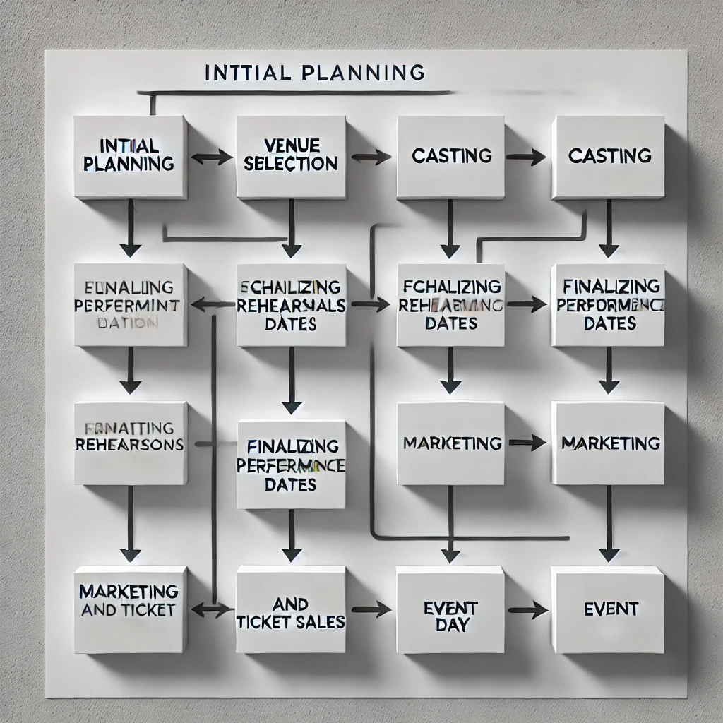
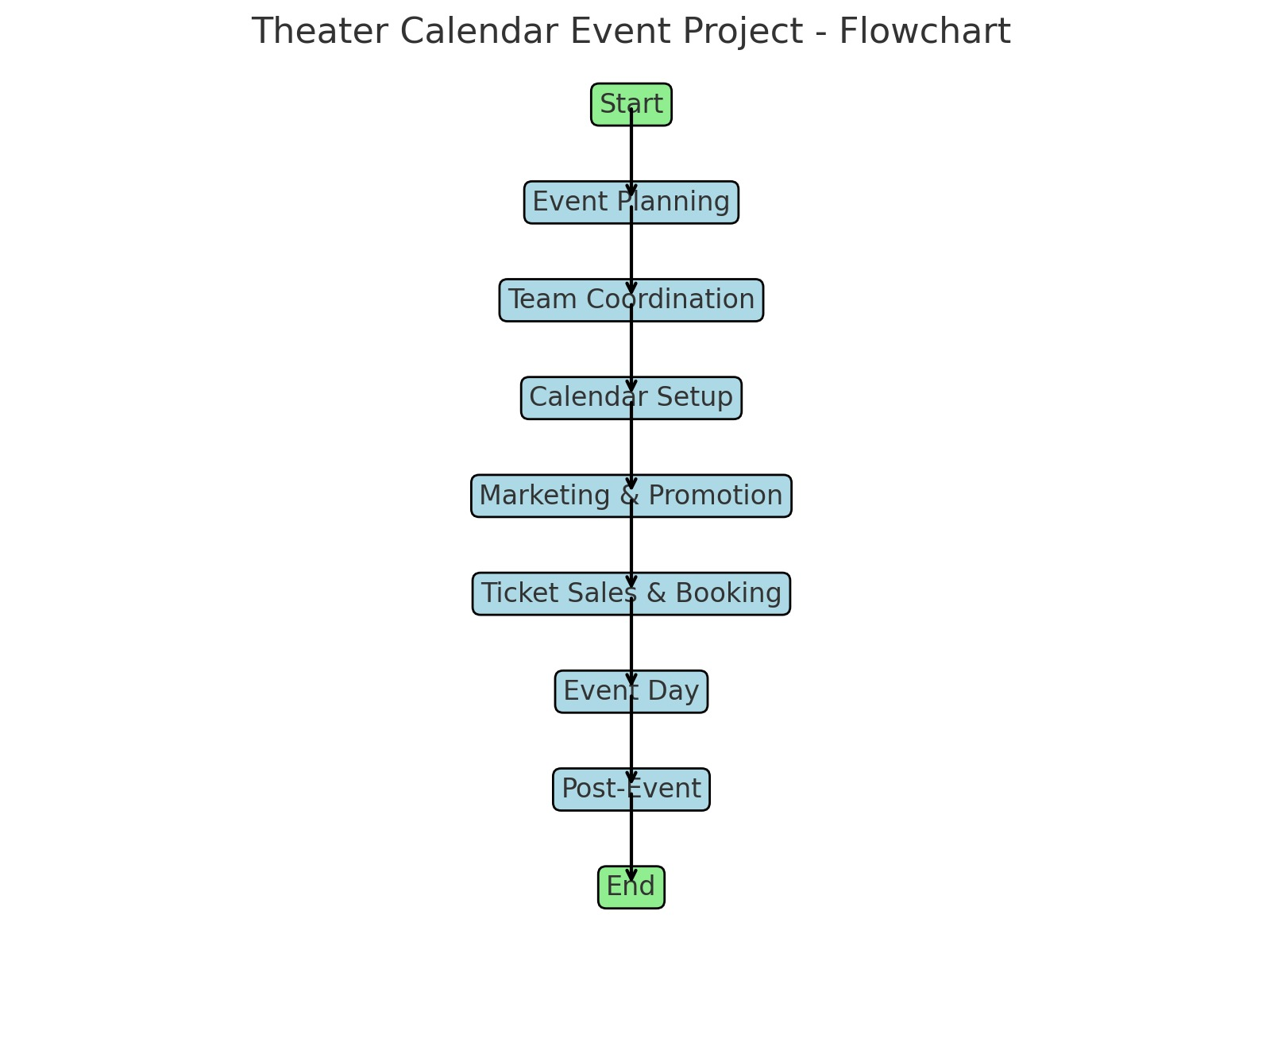
Architecture Diagram

Slide 8
Modules and Classes
1. Event Class:
Represents an event with event_id, name, start_time, and end_time.
Uses datetime.strptime to parse the start_time and end_time from strings into datetime objects.
2. Event Calendar Class:
Manages multiple Event instances using a dictionary.
Provides methods for adding, retrieving, updating, deleting, and listing events.
Ensures no duplicate event IDs are added and raises a ValueError if an event ID already exists or is not found for updates and deletions
3. OnlinePlatformSync Class:
A simple sync mechanism that "syncs" events to an external platform (in this case, just prints a message).
The sync_events_with_platforms method iterates over the events in the EventCalendar and prints the sync operation for each.

Slide 9
Benefits
1. Centralized event information
2. Streamlined event planning
3. Increased engagement
4. Improved communication
5. Enhanced overall experience
6.Saves time
7.Increases revenue
8.Enhances visibility
9.Improves organization
10.Boosts engagement

Slide 10
Conclusion
A Theatre Event Calendar is a vital tool for promoting theatre events, engaging audiences, and supporting the performing arts community.
By providing a centralized platform for event information and scheduling, the calendar enhances visibility, discoverability, and accessibility for theatre companies, venues, and audiences.
Future Enhancements
1.Integration with Social Media: Share events on Facebook, Twitter, Instagram
. Import events from social media platforms
2. Email Notification System: Send reminders and updates to users.
Notify administrators of new event submissions
3. User Reviews and Ratings: Allow users to rate and review events.
Display average ratings and reviews on event pages
4. Enhanced Search Functionality: Implement keyword search
Filter events by category, date, and location.

Slide 11
Reference
1. Eventbrite or Ticketmaster Calendars
2. Local Theatre Companies
3. Google Calendar or Outlook Template
4. Broadway or West End Theater Listings
5. University or High School Theater Calendars

Slide 12


